Slide 1

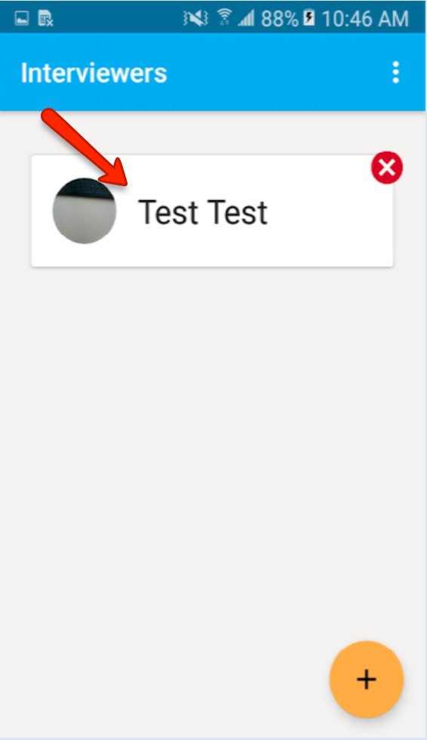
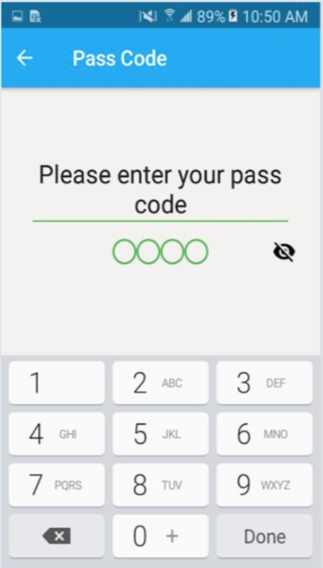
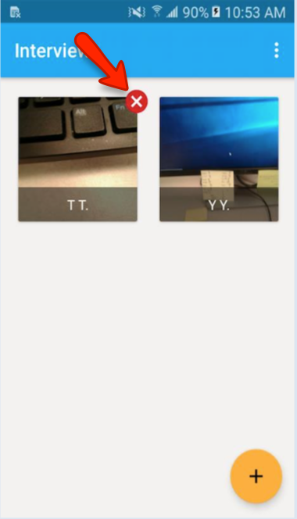
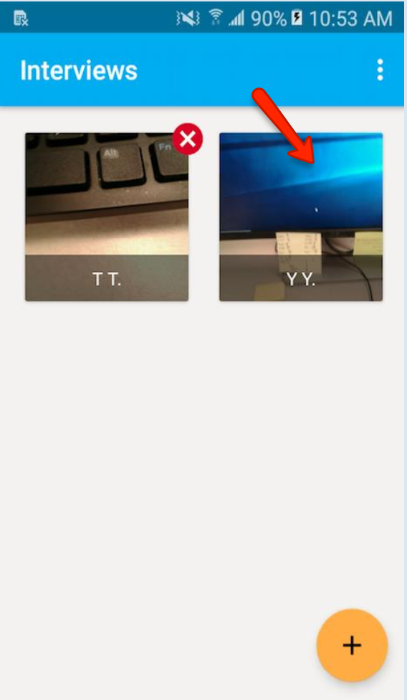
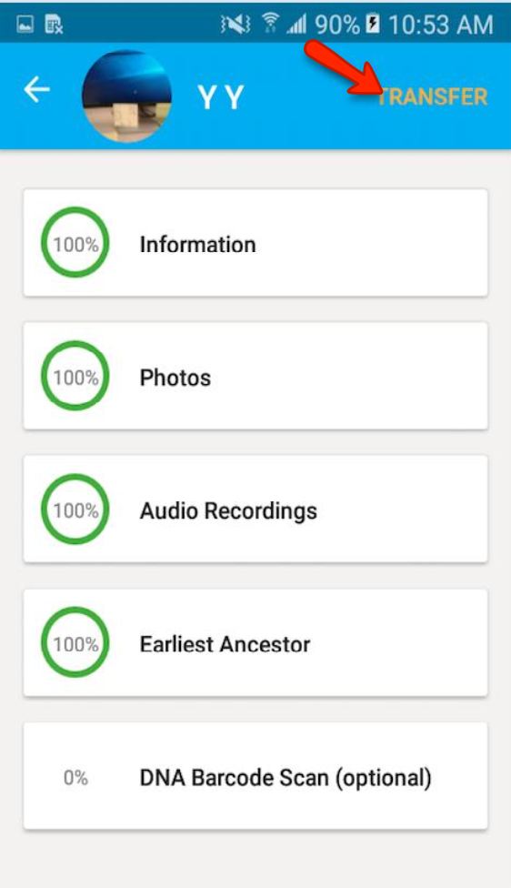
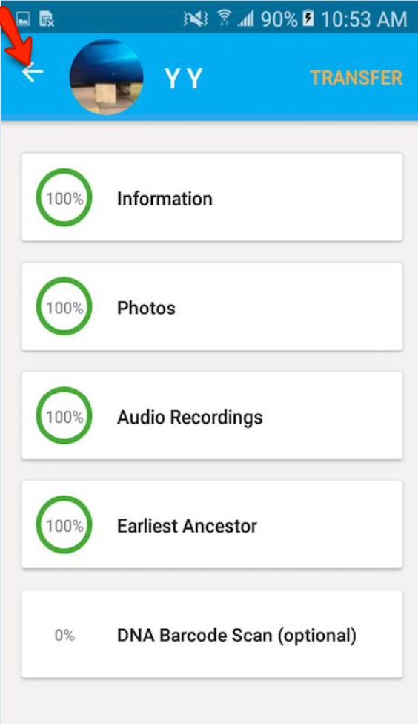
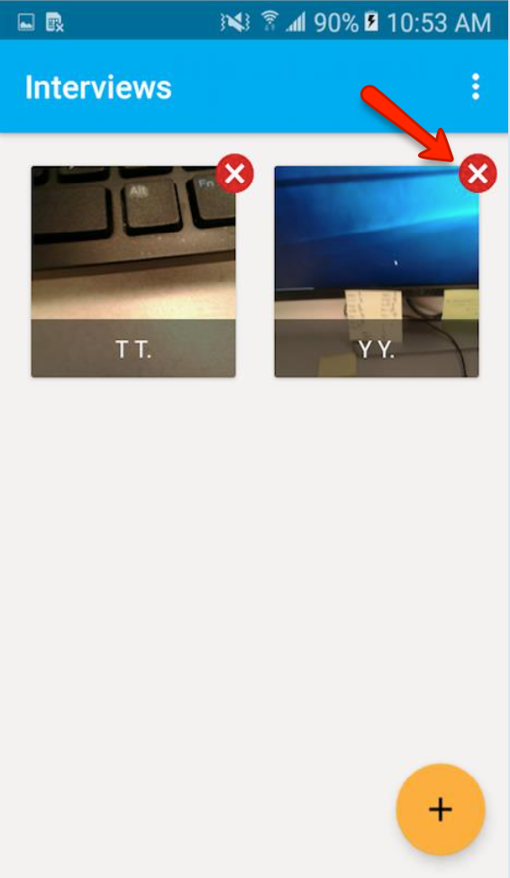
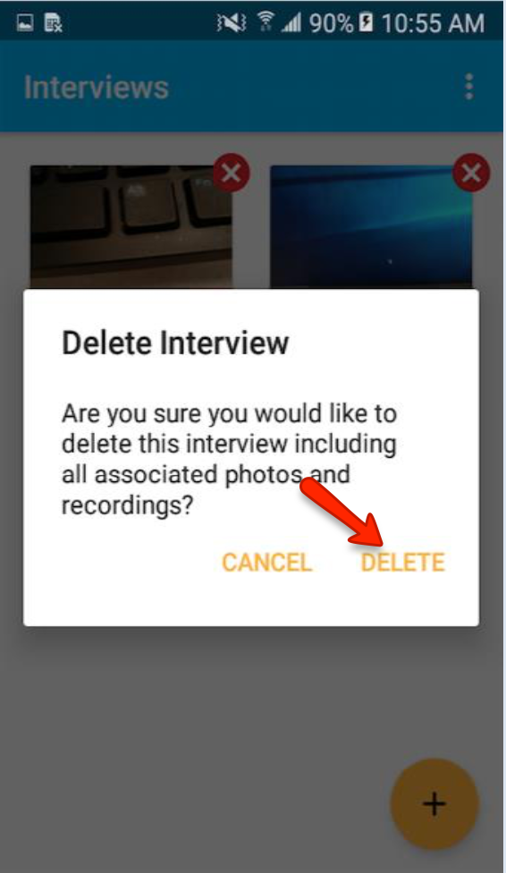
Deleting Interviews from the Mobile App
1. Tap the Interviewer
2. Enter Interviewer’s PIN
3. Tap the Red X to delete the interview OR…
4. If no Red X, Tap the interview
5. Tap [Transfer] to save the interview
6. Tap the arrow to return to interview page
7. Tap the Red X to delete the interview
8. Tap [Delete]

