Slide 1
ODBC Database Access:
Restriction Search

Slide 2
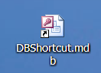
With the DBShortcut.mdb icon on your computer desktop, the Restriction Search database is ready to use.

Slide 3
How to Use the Restriction Search Database

Slide 4
Before checking the database . . .
Check the dates of the document to determine that all individuals listed or mentioned in the document are deceased. (Typically, if the document is more than 120 years old, all individuals will be deceased.)
If the document contains information on living individuals, it may not be used in the FamilySearch Wiki.

Slide 5
Locate the icon shown below on your desktop and click on it.

Slide 6
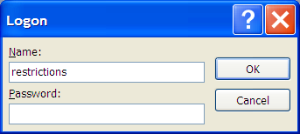
In the login screen, type the username and password shown below. Click “OK”
Name: restrictions
Password: search08 (case sensitive)

Slide 7
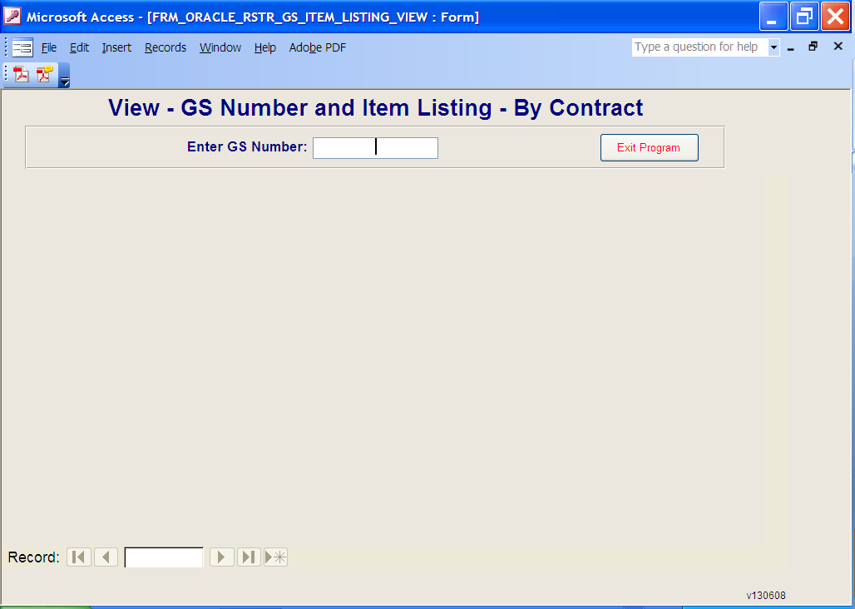
Type in the Microform Number (GS) and then press “Enter” on the keyboard.

Slide 8
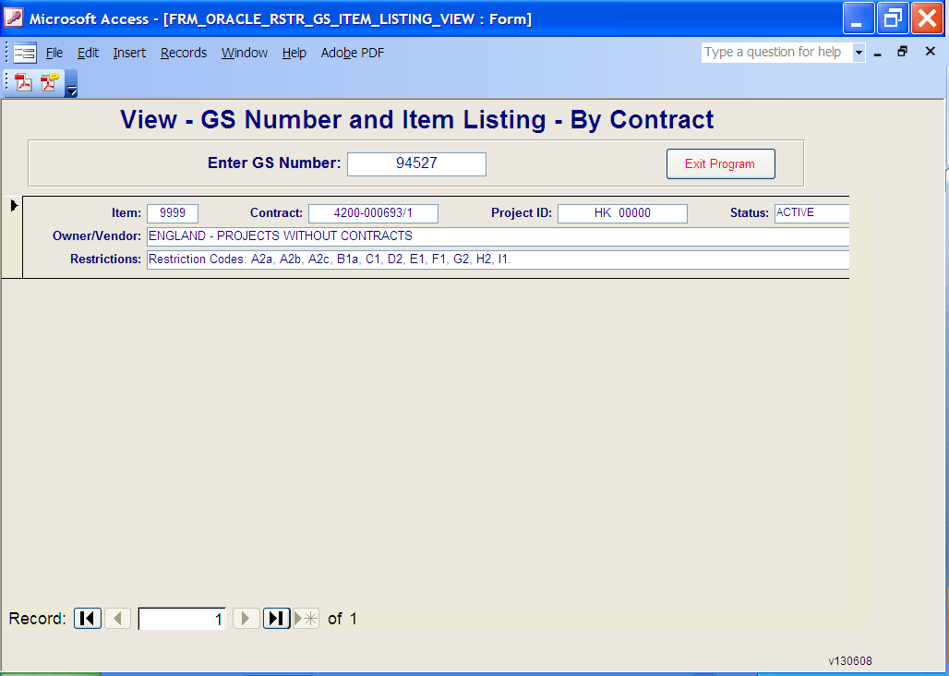
View the Restriction Codes
The image may be uploaded to the FamilySearch Wiki if any combination of these codes appear: K1, L1, M1, N1, and R1.

Slide 9
If any other codes exist in the Restrictions box, the image may not be uploaded.
View the Restriction Codes

Slide 10
Multiple Records may exist for a microform number if the circled number shown below reads more than “1”:

Slide 11
Summary: Approved Codes for posting images online:
Check the dates of the document to determine that all individuals listed or mentioned in the document are deceased. (Typically, if the document is more than 120 years old, all individuals will be deceased.) Reject the image if it lists any living individuals.
If the following codes are returned from querying the ODBC, the image may be uploaded to the FamilySearch Wiki: K1, L1, M1, N1, and R1.
If the image is acceptable, follow any special instructions associated with T9A in the ODBC database, and then upload the image to the FamilySearch Wiki using the “Upload the Image” instructions.
If the ODBC query returns any other codes than K1, L1, M1, N1, or R1, the image must be rejected.
If the image is rejected, send the user a letter explaining why the image was rejected.

