Slide 1
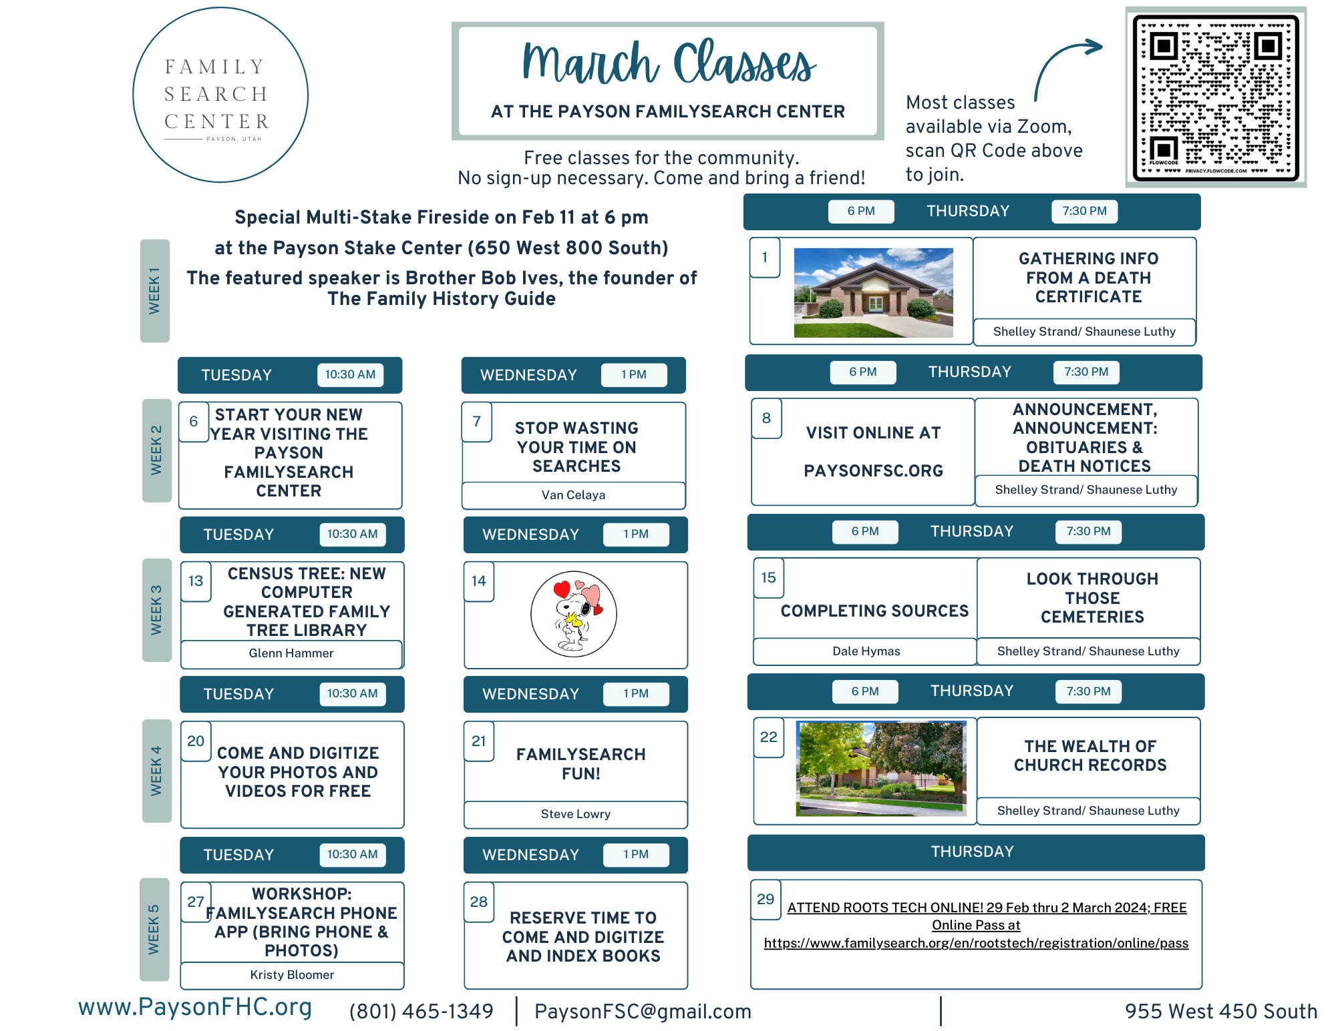
The Payson FamilySearch Center offers a variety of classes each month taught by amazing presenters. There just might be one listed below that you’ve been waiting for. Check it out; Attend in person or via zoom. The FamilySearch Center will host the following classes March.
Tuesday, March 5 - Preserving Audio Recordings in FamilySearch – Jim Banner
Wednesday, March 6 – Searching and Finding Tips – Glenn Wicker
Thursday, March 7 – Don’t Forget the City Directories - Shaunese Luthy
Thursday, March 14 – Using the New Family Search Website – Troy Mohrman
Tuesday, March 19 - Using the MEMORIES module in FamilySearch – Glenn Wicker
Wednesday, March 20 - Get Involved & Indexing – Steve Lowry
Thursday, March 21 - How to Find Land Records - Shaunese Luthy
The Payson FamilySearch Center has amazing scanning and digitizing equipment free for all to use with the help of consultants. You can reserve your own time.
Digitize your old audio cassettes, VHS tapes, photos, negatives, slides or books.
Don’t forget RootsTech 2024 - Thu, Feb 29 – Sun, Mar 3, 2024

