Slide 1
ODBC Database Access:
Restriction Search

Slide 2
Step 1:
Contact the TSRs and request that the new team member or missionary get access to the “RestrictionSearchDB” folder located on the “O:” drive.
Once the “RestrictionSearchDB” folder appears on the individual’s “O:” drive, proceed with the following steps.

Slide 3
Step 2: Install the Oracle in OraHome92 Driver
Using the following steps, the Oracle in OraHome92 Driver will install on the missionary or team member’s computer.
The Oracle in OraHome92 Driver is necessary to open the database used to check Family History Library Images.

Slide 4
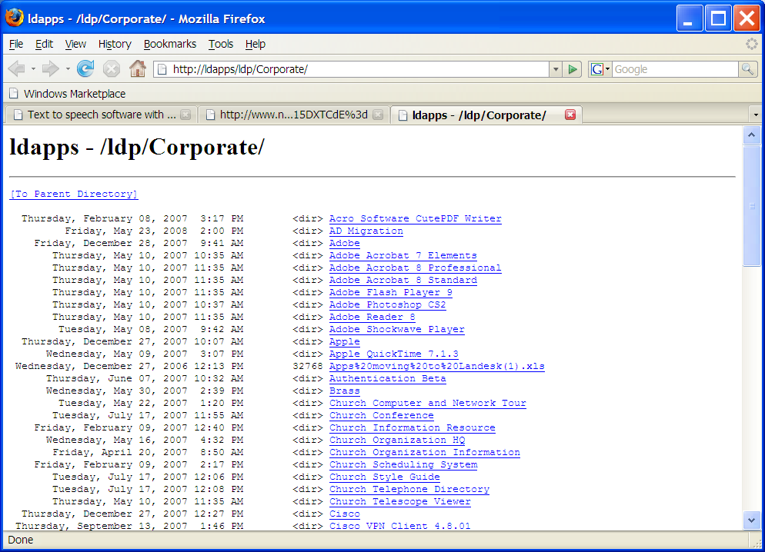
Go To http://ldapps/ldp/Corporate

Slide 5
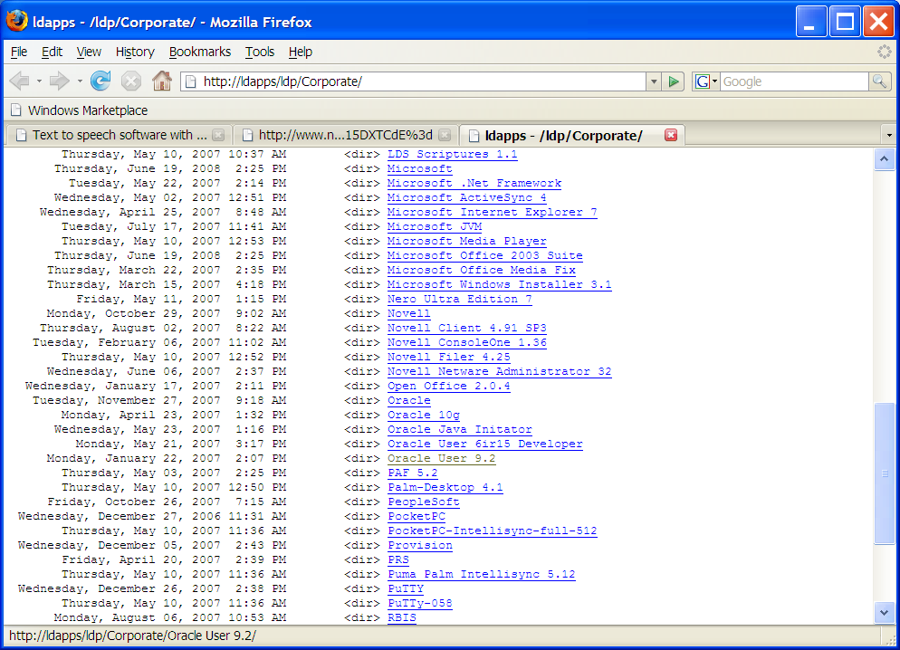
Click on “Oracle User 9.2”

Slide 6
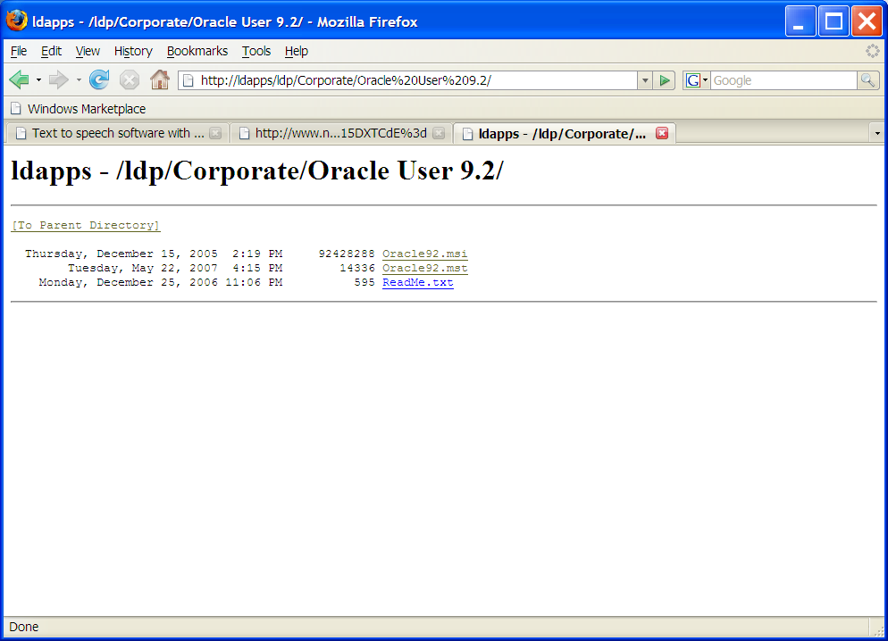
Click on “Oracle92.msi”

Slide 7
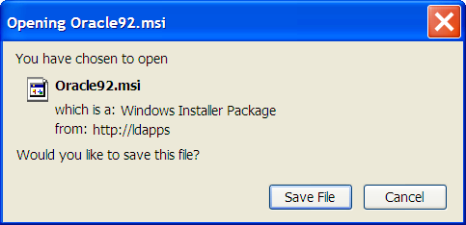
FireFox Download: Click “Save File”

Slide 8
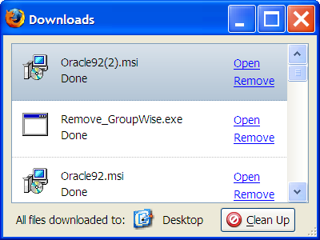
FireFox download: Click “Open” . . .

Slide 9
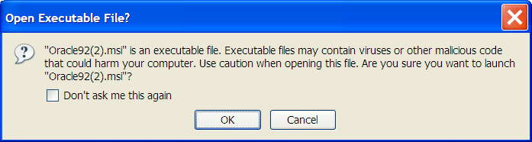
FireFox Download: Click “OK”

Slide 10
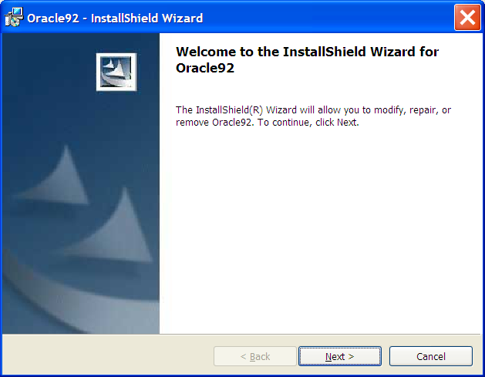
The InstallShield Wizard will open. Click “Next.”

Slide 11
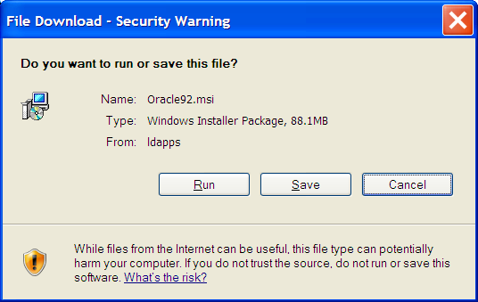
Internet Explorer: Click “Run”

Slide 12
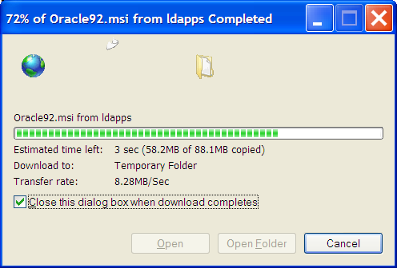
Internet Explorer: The file will download to the computer

Slide 13
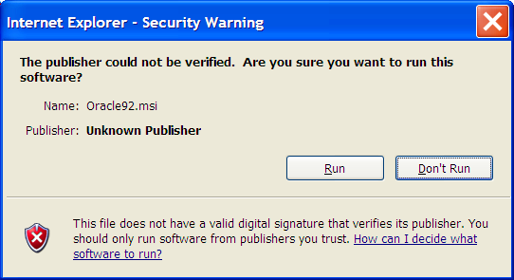
Internet Explorer: Click “Run”

Slide 14
The InstallShield Wizard will open. Click “Next.”

Slide 15
Step 3: Add the Oracle in OraHome92 Driver as an ODBC Data Source
Using the following steps, Oracle in OraHome92 will be added as a Data Source to make the Restriction DB accessible and viewable.

Slide 16
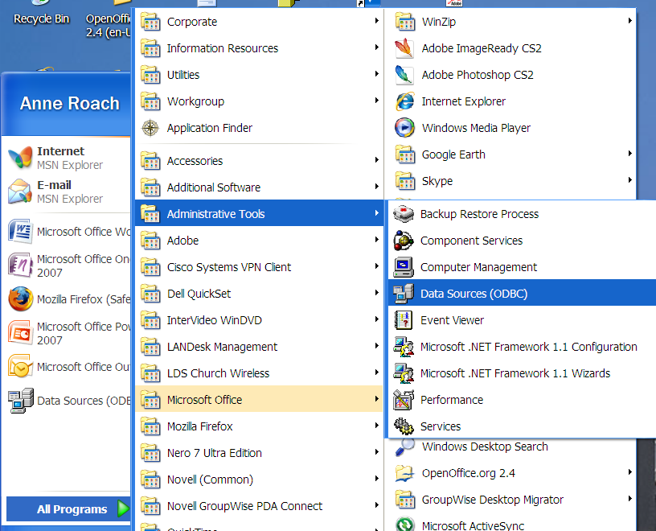
Click on the Start Menu, “Programs,” “Administrative Tools,” and then “Data Sources (ODBC)”

Slide 17
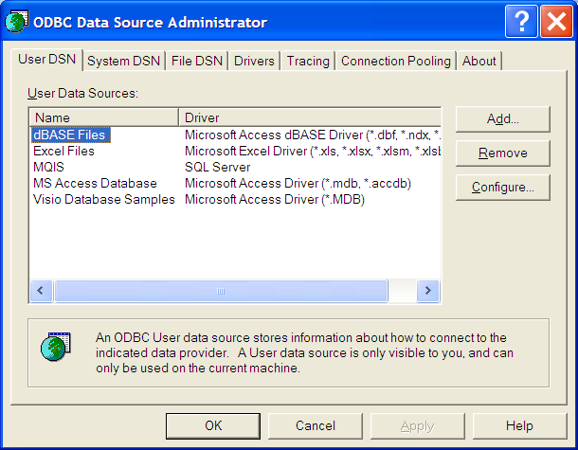
The ODBC Window will open. Click “Add.”

Slide 18
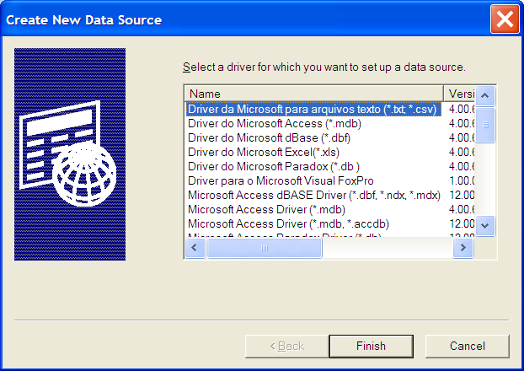
Click the slide bar

Slide 19
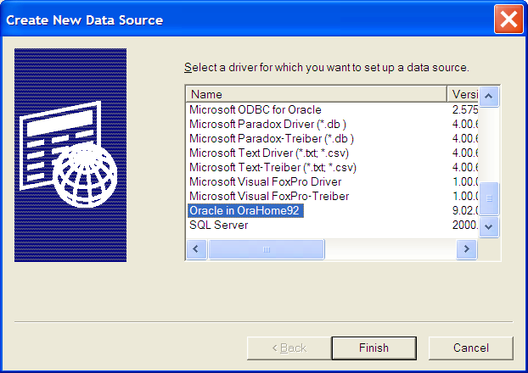
Click “Oracle in OraHome92,” and click “Finish.”

Slide 20
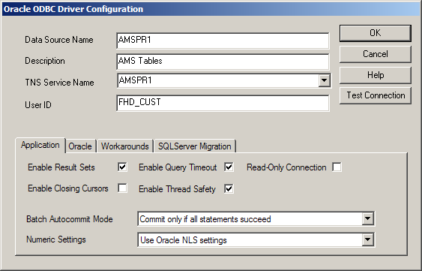
Fill in the next screen as follows:

Slide 21
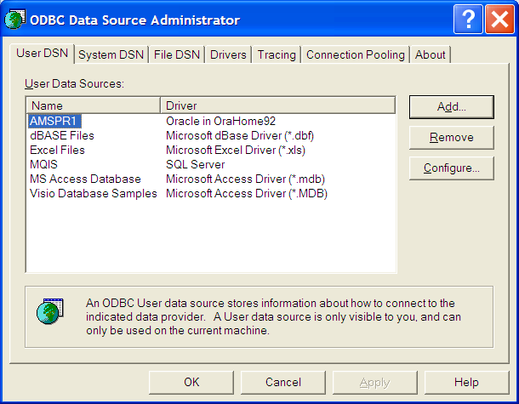
Oracle in OraHome92 will appear on the screen. Click “OK.”

Slide 22
Step 4: Place the O: Restriction DB shortcut on the user’s desktop
The following steps will show how to place the Restriction DB on the user’s desktop.
This will allow the missionary or team member to check FHL microform numbers for legal rights to post online.

Slide 23
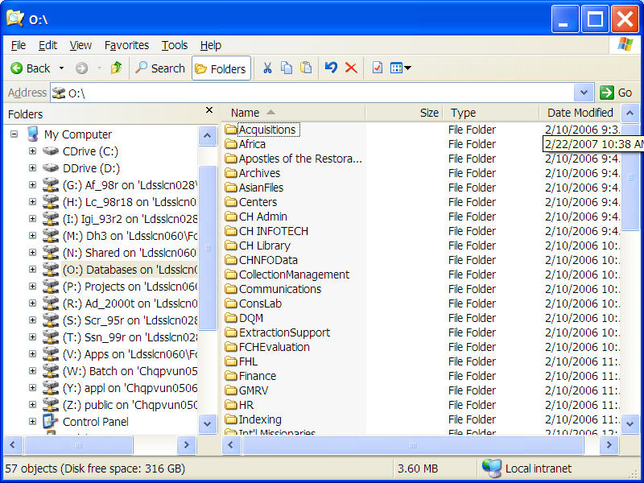
Click on “My Computer,” and then click on the O: Drive

Slide 24
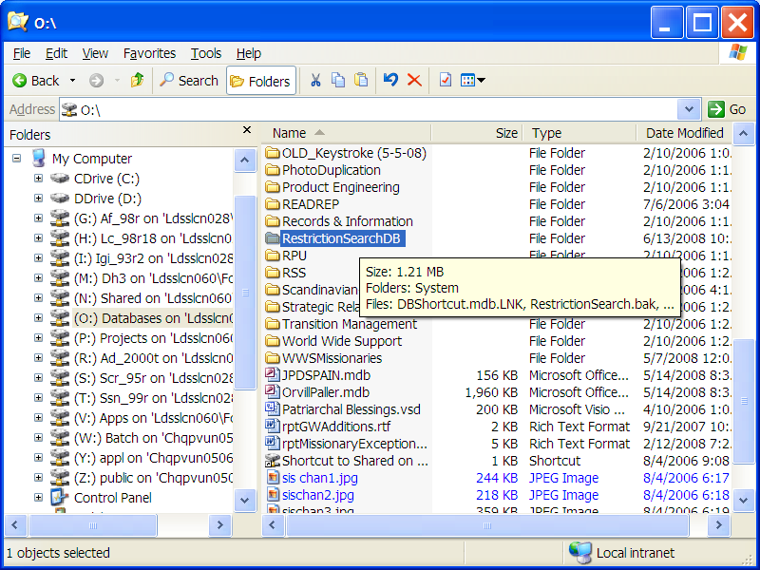
Open the “RestrictionSearchDB” folder by clicking on it.

Slide 25
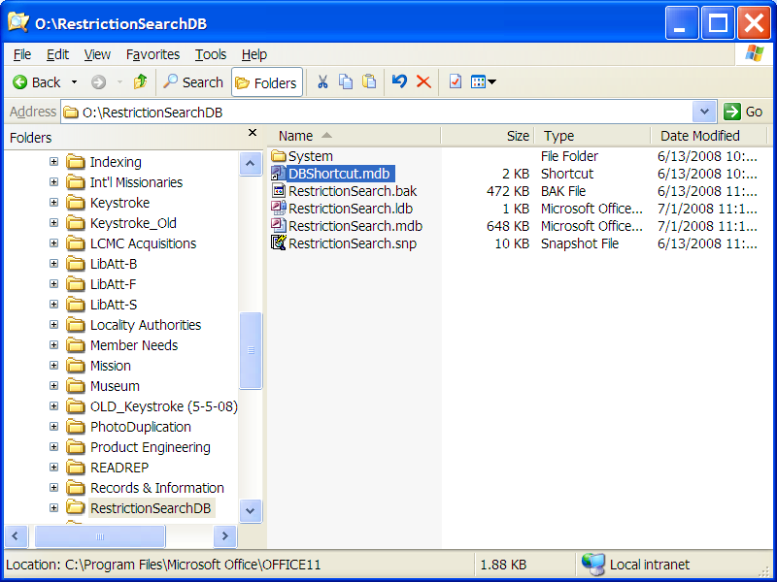
“Drag and Drop” the “DBShortcut.mdb” icon onto the computer desktop.

Slide 26
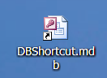
With the DBShortcut.mdb icon on the computer desktop, the Restriction Search database is ready to use.

Slide 27
How to Use the Restriction Search Database

Slide 28
Before checking the database . . .
Check the dates of the document to determine that all individuals listed or mentioned in the document are deceased. (Typically, if the document is more than 120 years old, all individuals will be deceased.)
If the document contains information on living individuals, it may not be used in the FamilySearch Wiki.

Slide 29
Locate the icon shown below on your desktop and click on it.

Slide 30
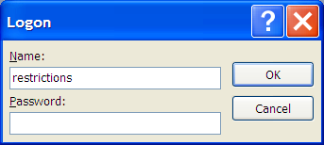
In the login screen, type the username and password shown below. Click “OK”
Name: restrictions
Password: search08 (case sensitive)

Slide 31
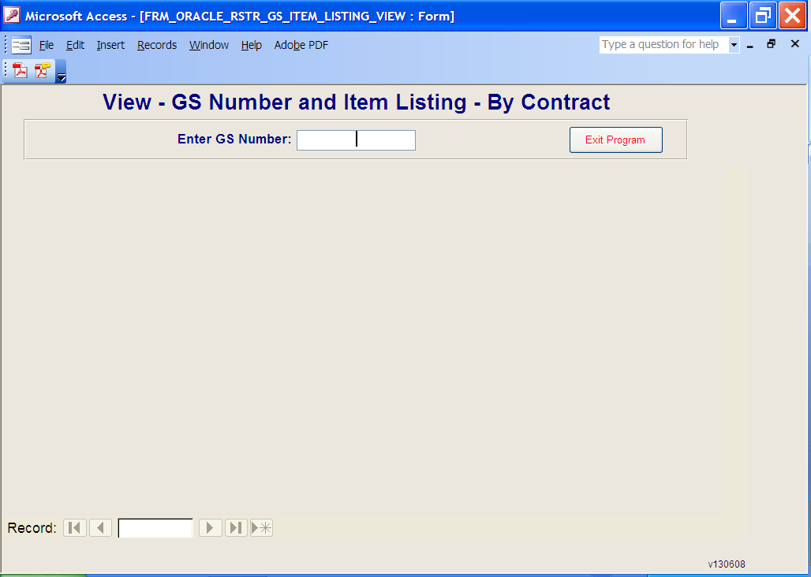
Type in the Microform Number (GS) and then press “Enter” on the keyboard.

Slide 32
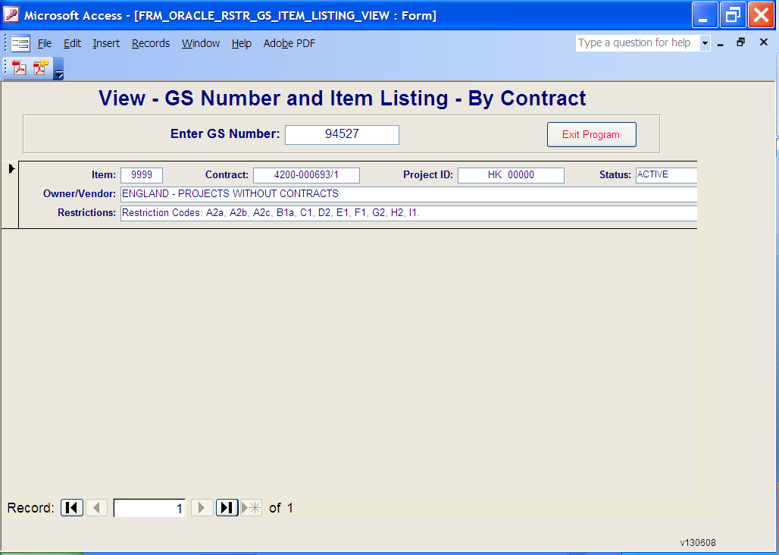
View the Restriction Codes
The image may be uploaded to the FamilySearch Wiki if any combination of these codes appear: K1, L1, M1, N1, and R1.

Slide 33
If any other codes exist in the Restrictions box, the image may not be uploaded.
View the Restriction Codes

Slide 34
Multiple Records may exist for a microform number if the circled number shown below reads more than “1”:

Slide 35
Summary: Approved Codes for posting images online:
Check the dates of the document to determine that all individuals listed or mentioned in the document are deceased. (Typically, if the document is more than 120 years old, all individuals will be deceased.) Reject the image if it lists any living individuals.
If the following codes are returned from querying the ODBC, the image may be uploaded to the FamilySearch Wiki: K1, L1, M1, N1, and R1.
If the image is acceptable, follow any special instructions associated with T9A in the ODBC database, and then upload the image to the FamilySearch Wiki using the “Upload the Image” instructions.
If the ODBC query returns any other codes than K1, L1, M1, N1, or R1, the image must be rejected.
If the image is rejected, send the user a letter explaining why the image was rejected.

